Slide 1

Sales Analysis using Power BI
End-to-End Data Analytics Project
Presented by Sneha Aggarwal

Slide 2
Setting the Stage
From Data Challenges to Strategic Insights
The Problem
Our Objective
Businesses often struggle to analyze large volumes of sales data manually.
To transform Superstore Sales Data into actionable insights using Power BI.
It becomes difficult to identify which regions, categories, and customers drive the most profit.
Build an interactive dashboard that:
Visualizes key sales, profit, and order metrics.
High discounts sometimes reduce profitability, but without proper analysis, businesses cannot spot these patterns.
Highlights customer and regional performance trends.
Identifies the impact of discounts on profit.
Empowers managers to make data-driven strategic decisions

Slide 3
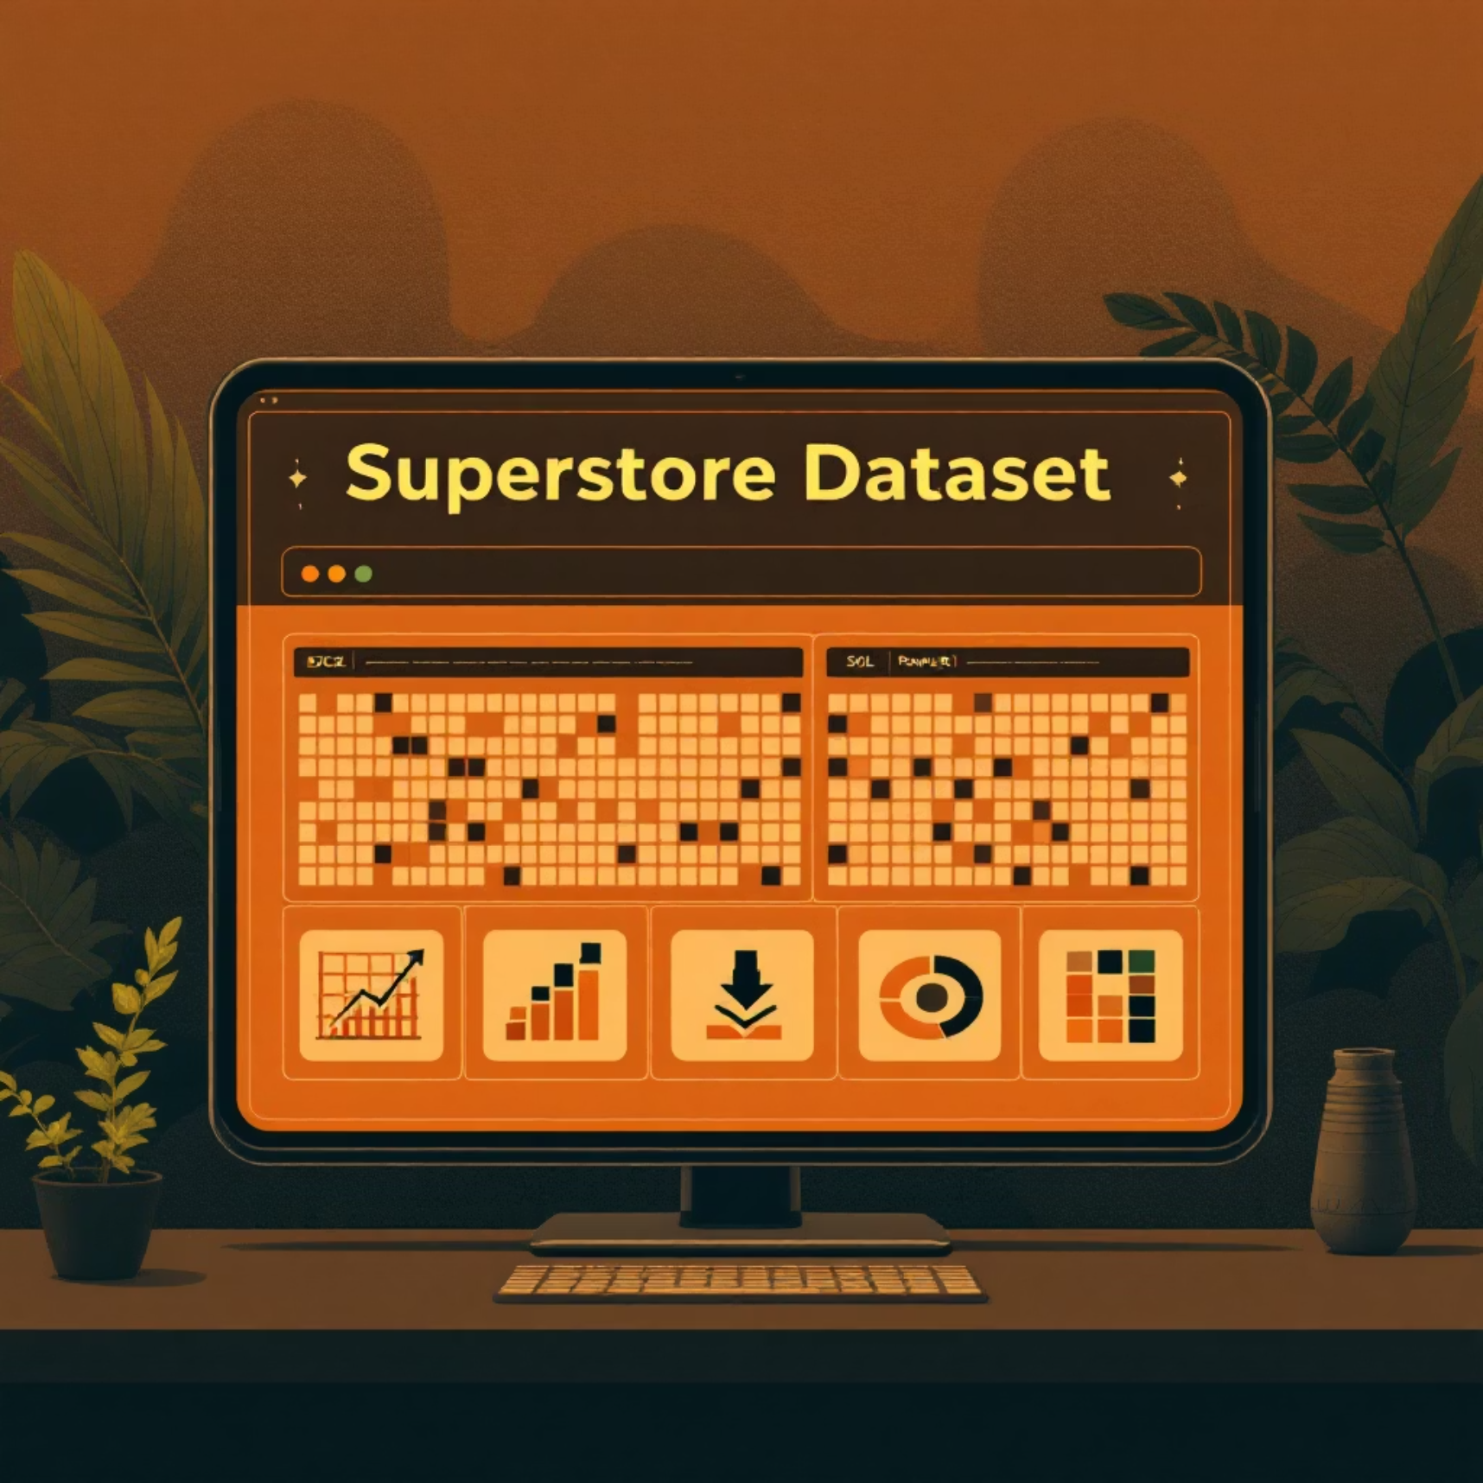
The Foundation
Understanding Our Data & Tools
Superstore Dataset
The dataset provides detailed sales transactions for a fictional retail store.
Size: ~10,000+ rows, 20+ columns.
Key Fields:
Order Details → Order ID, Order Date, Ship Mode
Customer Info → Customer ID, Segment, Region
Sales Metrics → Sales, Profit, Quantity, Discount
Product Info → Category, Sub-Category
Tools Utilized
Excel – for quick data review & preprocessing (removing duplicates, formatting).
Power BI – for:
Data modeling & cleaning
Creating KPIs (Sales, Profit, Orders)
Interactive dashboards & visualizations

Slide 4
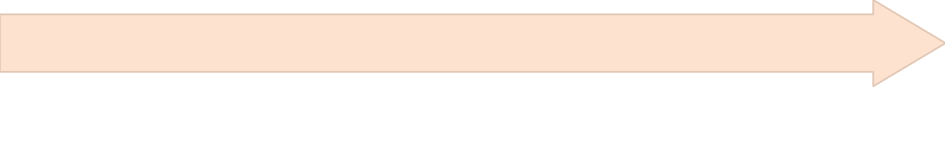
Refining the Raw
Data Cleaning & Preparation
Before analysis, ensuring clean and consistent data was essential to build a reliable dashboard.
Data Type Transformation
Duplicate & Missing Value Removal
Converted Order Date into proper date format and ensured Sales/Profit/Discount were numeric.
Identified and removed duplicate rows; handled missing records for consistency.
Format Standardization
Data Modeling in Power BI:
Standardized column names, categories, and values to avoid inconsistencies.
Established relationships between Orders, Customers, and Products for seamless reporting.

Slide 5
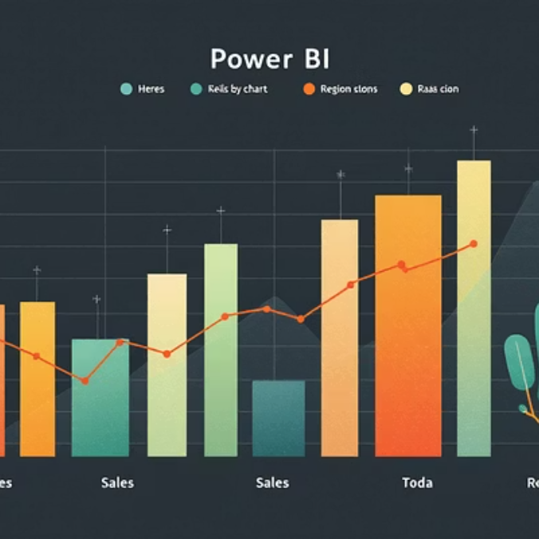

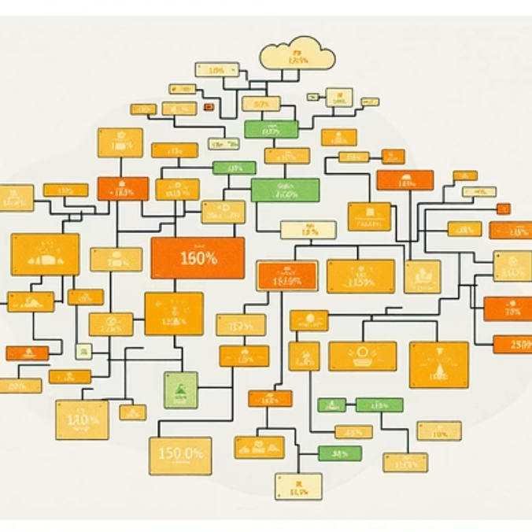
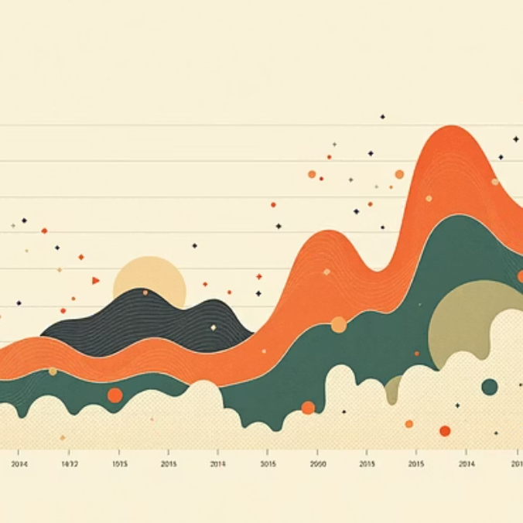
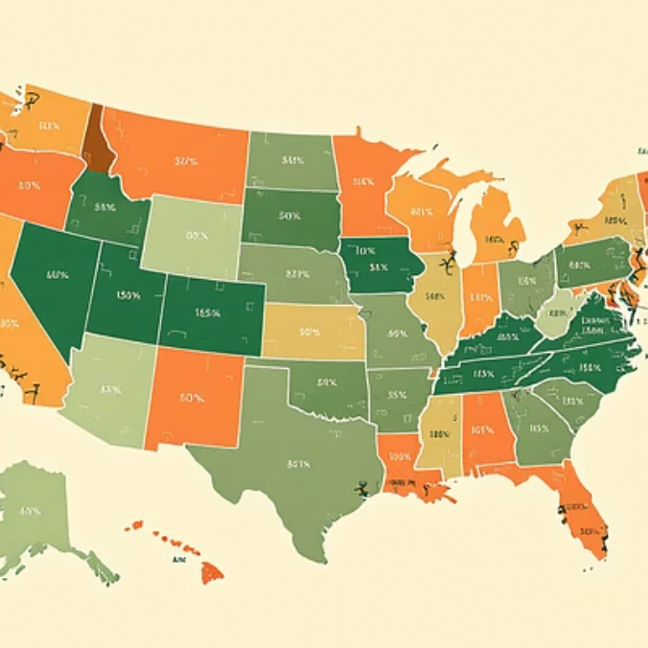
Bringing Data to Life
Key Visualizations in Power BI
A diverse set of charts were created to explore different facets of the Superstore data, offering immediate visual understanding.
Sales by Region → Clustered Bar Chart (West leads, South lags)
Sales Trend over Time → Line & Clustered Column Chart (steady growth, seasonal spikes)
Profit by Category & Sub-Category → Tree Map (Technology most profitable, Furniture lags)
Discount vs. Profit → Scatter Plot (higher discounts → lower profit in Furniture)
Key KPIs → Cards displaying Total Sales, Total Orders, and Total Profit

Slide 6
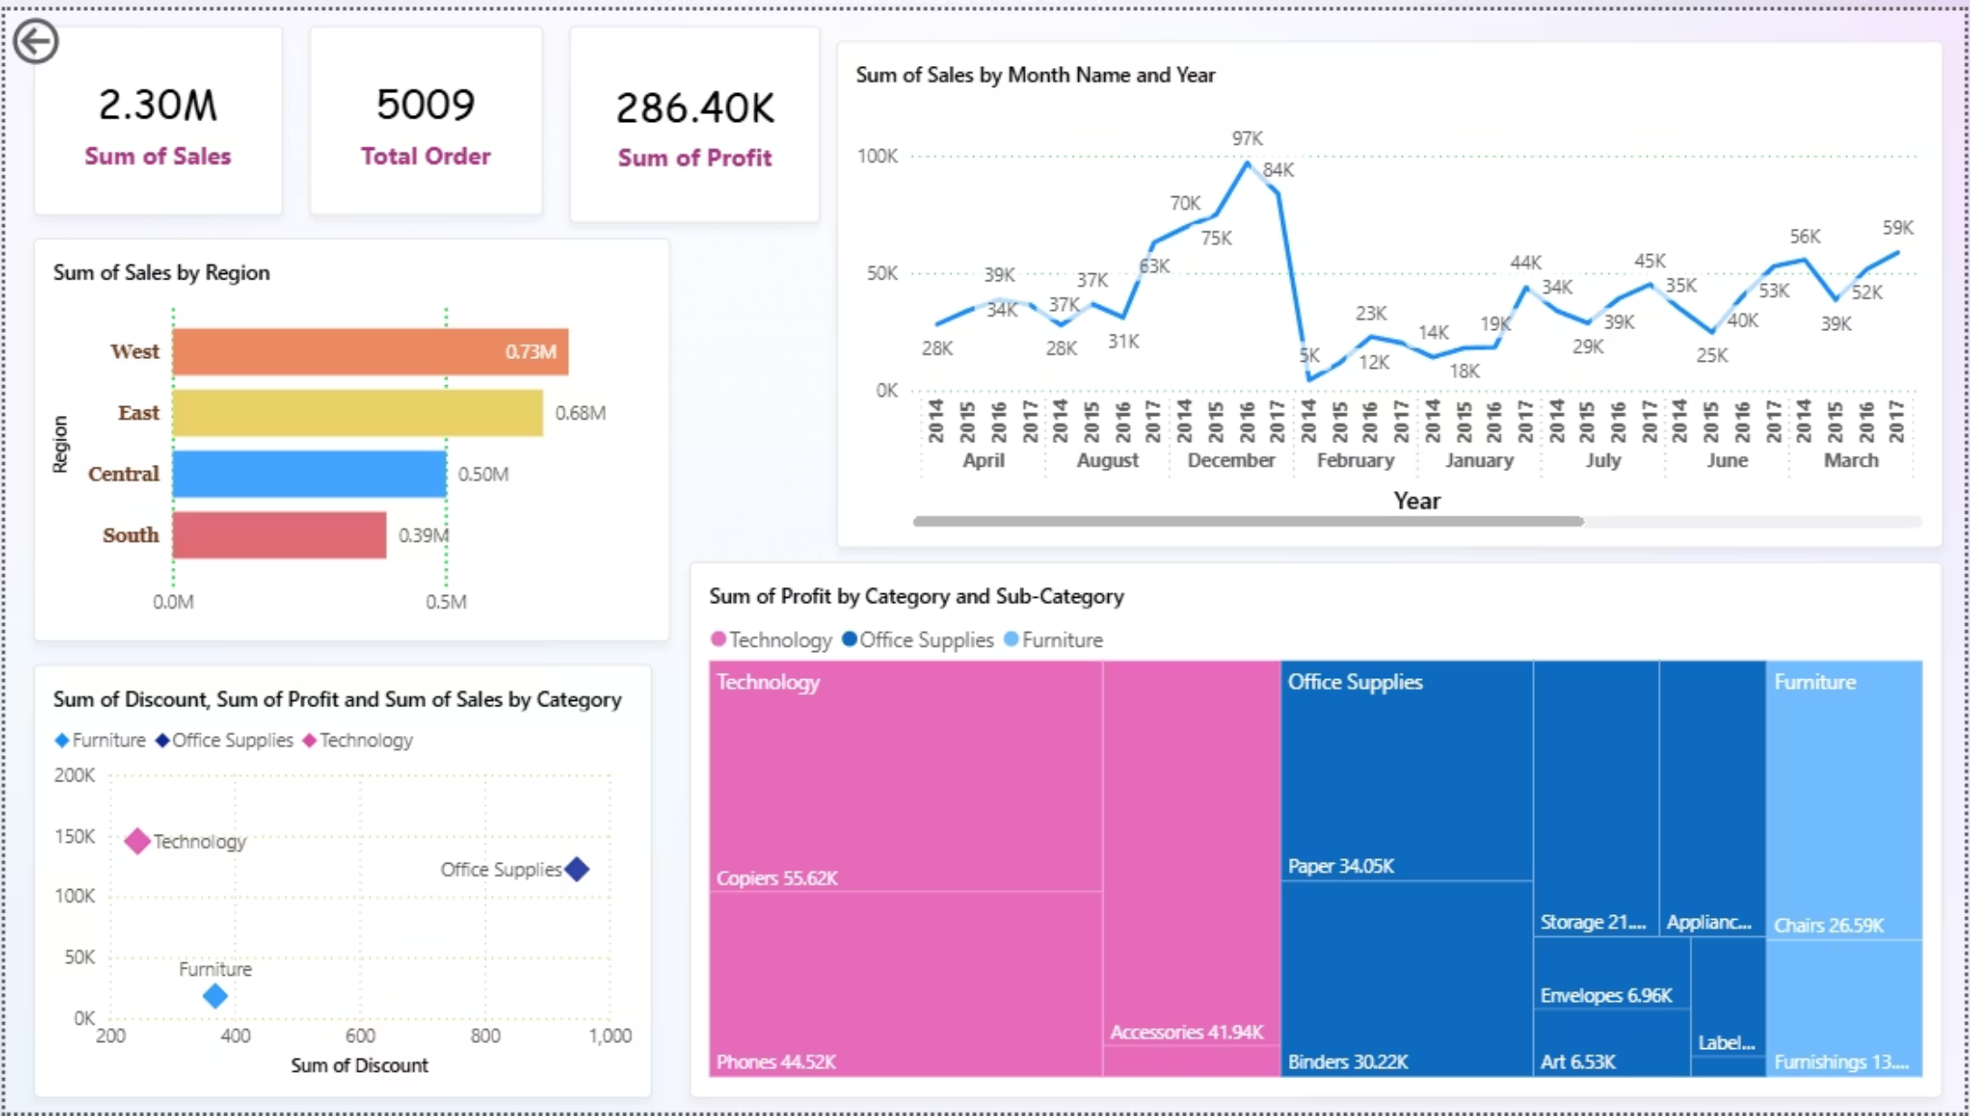
The Full Picture
Interactive Sales Dashboard
Interactive Filters & Slicers
Clear KPI & Chart Layout
Manager-Friendly Navigation
Users can drill down by region, time period, or category to uncover deeper insights.
Key Performance Indicators (Sales, Profit, Orders) are displayed alongside intuitive visuals for quick decision-making.
Built for simplicity, allowing managers to explore trends and answers without technical expertise.

Slide 7
Unveiling the Story
Key Sales Insights from the Data
The dashboard quickly highlighted several critical trends and patterns:
Regional Disparities
Category Profitability
West region consistently led in sales, while the South region showed the lowest performance, indicating untapped potential.
Technology emerged as the most profitable category. Conversely, Furniture consistently delivered the lowest profit margins.
Seasonal Sales Peaks
Discount Impact
A clear sales spike was observed in December, suggesting strong seasonal buying patterns or successful year-end promotions.
Analysis revealed that aggressive discounts within the Furniture category directly correlated with significant profit erosion.

Slide 8

Actionable Strategies
Business Recommendations
Based on these insights, we can formulate targeted strategies to optimize sales and profitability:
Boost Technology Category → Focus marketing & cross-selling efforts on Technology, the most profitable segment.
Rationalize Furniture Discounts → Limit deep discounts, adopt bundled offers to protect margins.
Strengthen South Region → Launch targeted campaigns and distribution expansion to unlock growth potential.
Leverage Seasonal Demand → Prepare inventory & promotions ahead of Nov–Dec peak sales.

Slide 9



Beyond the Dashboard
Future Scope for Advanced Analytics
This project lays a strong foundation, but there's always more to explore with data:
Predictive Analytics
Customer Segmentation
Real-Time Data Integration
Forecast future sales & demand → helps in proactive inventory & revenue planning.
Use ML to group customers → enables targeted marketing & personalized offers.
Live data connection → instant monitoring & faster business decisions.

Slide 10

Thank You!

